Slide 1
Milestones in psycholinguistics
Wundt’s experimental work
Early progress in neurobiology of language
Structure-function relationship
Behaviouraim ( Skinner)
Chomsky
Modularity
Critical period in language acquisition
Advancements in methods
Embodiment
Language disorders
Rise in computational support
Brain imaging in real time

Slide 2
War of ideas
Continental rationalism ( Kant, Chomsky)
British empiricism ( Hume , later behaviorists, Blank slate argument)
American analytical philosophy ( Quine)
Positivism ( led to computationalism)

Slide 3


Slide 4
Innate Mechanisms (Pinker, 2005)
From a cognitive perspective, such mechanisms include
a sense of spatial representation
the ability to grasp the thoughts of others
a language instinct
decision rules that govern behavior
Other human drives can only be understood within the context of evolution.

Slide 5
Chomsky’s Linguistics
Chomsky proposed that grammars could be evaluated at three levels:
Observational adequacy
Must be able to predict acceptable and unacceptable sentences
Descriptive adequacy
Explain how sentences with similar meanings are related (e.g., active and passive sentences)
Explanatory adequacy
Must be able to explain how languages are acquired and the similarities and differences across languages (language universals)
Notes:
Chomsky’s dissatisfaction with the descriptive adequacy of linguistic theories to date (in the 1950’s) led to the development of his theory of transformational grammar

Slide 6
Transformational grammar
Chomsky (1957, 1965)
Two stages phrase structures for a sentence
Build Deep Structure
Build from phrase structure rules
One constituent at a time
Convert to Surface Structure
Built from transformations that operate on the deep structure
Adding, deleting, moving
Operate on entire strings of constituents
S --> NP VP
VP --> V (NP)
NP --> (A) (ADJ) N

Slide 7
Psychological reality of syntax
Derivational theory of complexity
The more transformations, the more complex
The boy was bitten by the wolf
The boy was bitten. (involves deletion)
No evidence for more processing of the second sentence
Evidence for (trace)
Some recent evidence or reactivation of moved constituent at the trace position
Evidence for syntax
Syntactic priming

Slide 8
Miller and McKean (1964) (quoted by Harley 1996) and Fodor 1974) argued that the more transformations there are in a sentence, the more difficult it would be to process. They looked at ‘detransformation’ reaction times to the sentences such as:
The robot shoots the ghost. (0 transformations, active affirmative)
The ghost is shot by the robot. (1 transformation, passive affirmative)
Is the ghost not shot by the robot? (3 transformations, passive, negative, question)
Miller and McKean discovered that the time it took to comprehend sentences was directly related to the number of transformations in them. ‘This was interpreted as supporting the psychological reality of transformational grammar.’ (Harley 1996)

Slide 9
Problems with DTC
A syntactically complex but semantically simple construction will probably take less time than a syntactically simple but semantically complex construction. According to Fodor (1974) ‘there is a residual interaction of response time with the truth or falsity of the sentence, which suggests that some purely semantic variable is operative (Fodor 1974).
Another area of objection on DTC came from computer processing models. The notion that complex structures will take longer to process because the have more underlying transformation to be sorted out assumes that these underlying transformations are processed in a linear way. People argued that this may not necessarily be the case. What about parallel processing in which multiple computations are done at the same time?
The apparent failure of the DTC had some profound after effects. According to Harley (1996) this ‘has effectively led to a separation of linguistics and psycholinguistics’. Miller who earlier on provided the first ever empirical support for the psychological reality of TG grammar, later came to believe that all the time taken in sentence processing was used in semantic operations. Another group of scholars held Transformational Generative Grammar responsible for the failure of DTC by asking whether the failure was due to the poor syntactic theory? This led to a substantial modification of TG theory.
Fodor, J. (1974) The Psychology of Language. McGraw-Hill Book Company. New York.

Slide 10
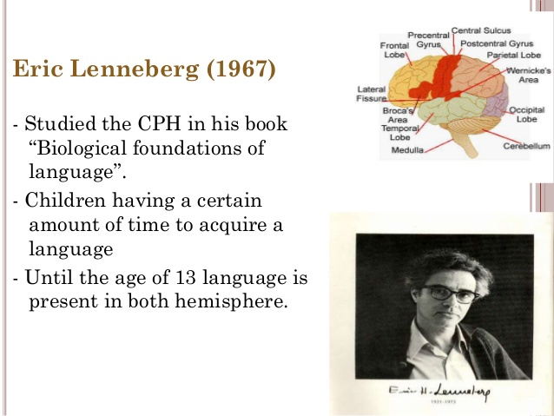
Critical period Hypothesis

Slide 11
Constraints on language leaning
Brain maturation lays a role in language learning
Input plays critical role
L2 acquisition difficult after a certain age

Slide 12
About critical periods
It’s pretty uncontroversial that there is some decline in the ability to learn language that happens with age. Nobody disputes the fact that it’s harder to learn a second language later in life.
The question is: Is this caused by an irreversible neurological change? (A critical period) Is it impossible to “learn an L2” after the end of the critical period? Or does it just get harder to learn stuff as you get older? Why does it seem to be particularly acute with language learning?

Slide 13
Why isn’t it strange that there should be (a) critical period(s)?
…Critical periods of development generally do not have sharp time boundaries. Different layers within one region of the brain may have different critical periods of development, so that even after the critical period for one layer has passed, rearrangement of the layer may still be possible because the entire region has not yet fully developed. For example, 8 weeks after birth layer 4c in the visual cortex of the monkey is no longer affected by monocular deprivation, whereas the upper and lower layers continue to be susceptible for almost the entire first year.. (Kandel, Schwartz, Jessell 3d ed. 1991, p. 957)

Slide 14
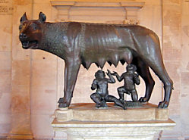
Feral children
Socialising, teaching and observing
Problems
- ethical experiments?
- teacher=researcher bias
- relation between lack of language and mental + social retardation
Notes:
Wild Peter enticed and trapped (aged 13)
In 1724, near the German town of Hamelin, a boy, described as a naked brownish black-haired creature, was seen running up and down in the fields. The boy was enticed into town, and once there immediately became a subject of great interest. He behaved like a trapped wild animal, eating birds and vegetables raw, and when threatened, he sat on his haunches or on all-fours looking for opportunities to escape.
Wild Peter moves to England
Wild Peter was soon made the possession of King George I of England, where he lived the rest of his life. During his life Peter never learned to talk, showed a complete indifference to money or sex, and was never seen laughing. However he loved music, could be taught a number of menial tasks, and when he once got lost, he found his own way back home. Peter died in Hertfordshire (England) in 1785.
Was Wild Peter really a feral child?
Although Wild Peter was famous in his time and his case is well known today, he was barely a feral child. He'd been living in the wild for only around a year, having run away from home owing to the physical abuse he suffered at the hands of his father. He was found and returned home, but in the meantime his father had re-married, and this time his stepmother threw him out. His inability to speak and other characteristics could have led to the abuse.
Found in the forest (aged 11)
Victor was first sighted wandering in the woods near Saint Sernin sur Rance, in southern France, at the end of the 18th century. He was captured but subsequently escaped, and wasn't retaken until January 1800 when he emerged from the woods. Aged about 12, he couldn't speak and bore a number of scars, suggesting he'd been in the wild for some time.
Why he was called Victor
Victor was given his name after the leading character in the play Victor, ou l'enfant de la forêt, the oddly prescient melodramatic play — indeed, the first fully developed melodrama — by René Guilbert de Pixérécourt, written in 1797/8, first produced in 1798 and published in 1803, and itself based on a book with the same name written by François Guillaume Ducray-Duminil in 1796.
Who was Victor?
Recent research into local and national archives in France suggests that Victor was probably abandoned by his family. There are suggestions that there was a child living in the area who could not speak.
Human or animal?
Victor's discovery coincided with the age of Enlightenment, when debate raged about what exactly separated humans from animals, and he was thus ideal experimental fodder for the scientists, just as Genie was so many years later. Victor eventually ended up with Itard, who wanted to teach him to speak and generally civilise him, but Itard made little progress.
What became of Victor?
Victor, the wild boy of Averyon, died at the age of 40 at an annexe of the Paris Institution des Sourds-Muets at 4 Impasse des Feuillantines where he lived with Mme Guérin.
Kaspar Hauser turns up out of the blue
Kaspar Hauser was discovered in 1828, walking down the road in Nuremberg, Germany. Kaspar was oddly dressed and unsteady on his feet, with a strange letter in his pocket and the phrase 'I want to be a horseman like my father is' on his lips. Although about 16 years old, he behaved like a small child. When eventually he could talk, he explained that he had been confined in a small cell into which food and insufficient water — he was always thirsty — were placed while he slept.
Kaspar Hauser's development
When Kaspar was released, he barely had the use of his fingers and had the gait of a toddler. However, unlike many other feral children, Kaspar did learn a lot, and was able to talk, read and write. We can assume from this that he probably learned to talk before his incarceration. Nevertheless, the development of his brain was profoundly affected.
On autopsy, the brain of Kasper Hauser was notable for small cortical size and few, non-distinct cortical gyri — all consistent with cortical atrophy. (Dr Bruce D Perry, Childhood Experience and the Expression of Genetic Potential)
Kaspar claimed that he had been confined for 10-12 years, an estimate that could well be right: or it could have been a much shorter period.

Slide 15
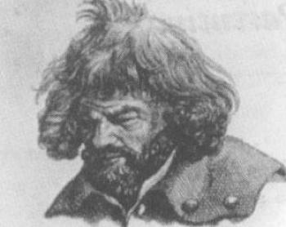


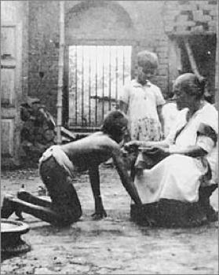
Wild Peter (13/1724) Victor (11/1800) Kaspar Houser (16/1828) Kamala and Amala (18m., 8/1920)

Slide 16

Genie
Found: 13/1970
Severe social isolation
Thought to be mentally retarded
Punished for speech
20 words, colours,”stoppit”, „nomore”
Notes:
The Story of Genie
On November 4, 1970 a girl was discovered. She had been locked in a room alone for over ten years. She was tied to a potty chair and left to sit alone day after day. At night, she was tied into a sleeping bag which restrained her arms. She was put into an over-sized crib with a cover made of metal screening. Often she was forgotten. On those nights she slept tied to the potty chair.
At first, people could hardly believe that Genie was thirteen years old. While she seemed to understand a few words, the only words she could say were, "stopit" and "nomore." She had a strange bunny-like walk— she held her hands up in front of her like paws and moved in a halting way. She could not chew solid food and could hardly swallow. She spat constantly. She sniffed. She was not toilet-trained and could not focus her eyes beyond 12 feet. She weighed 59 pounds and was 54 inches tall.
Genie was rescued and put in Children's Hospital in Los Angeles, California. Genie's mental and physical development began almost immediately. By the third day in the hospital, Genie began helping dress herself and using the toilet voluntarily. She began moving more smoothly. She was hungry to learn words, pointing at things until people would give her a word for them.
Scientists wondered, "Did Genie have a normal learning capacity? Could a nurturing, enriched environment make up for Genie's horrible past? Would it be possible for Genie to recover completely?" This is how the "experiment" began.
A team of scientists (referred to as the Genie Team) began working with Genie. They wanted to find out what they could about how humans learn. Over 200 years ago, scientists had studied another "wild child" in France named Victor. They called that case "The Forbidden Experiment." Genie's case was similar because it would be unthinkable to lock up or put a child in such severe isolation on purpose.
But having discovered a child who had been isolated, scientists wanted to learn from that experience. Was that wrong? As with Victor, people wondered if scientists should be studying Genie. Could she be both studied and taken care of well? Or should the Genie research be forbidden?
Within several months Genie had a vocabulary of over one hundred words that she understood, though she was still very silent. Her talking was limited to short high-pitched squeaks that were hard to understand. The team of scientists discovered that Genie had been beaten for making noise. It was hard to know if her inability to talk was a result of living so long without interacting with other humans, being in an impoverished environment with little sensory stimulation, or because she had been abused.
Genie began to become emotionally attached to some of the scientists who spent time with her. One scientist made sure that he was there every morning when Genie woke up, for important events during the day, and to put her to bed each night, in order to build a sense of family. Some people thought that it was necessary to feel connected to other humans before one could learn to speak. After about six months, Genie lived in a foster home. The father of the family she lived with was the head of the Genie Team.
Genie continued to recover and develop. She ran, giggled, and smiled. People commented that in some ways she seemed like a normal 18-20-month-old child. If you were to give her a toy, she would feel it gently first with her fingertips. Then she would rub it against her mouth and face, using her lips to feel the object. Genie did not seem to know when to use her eyes and when to use her sense of touch.
Genie's scientist "friends" took her on daily outings—walks through the neighborhood, visits to stores. Genie was so curious and hungry for experiences. She would demand to know the names for all the things in stores, almost faster than she could be told. She would pick up items and intently explore them. Even strangers felt compelled to help her learn about the world. A butcher, who knew nothing about Genie, used to hand her an unwrapped bone, piece of meat or fish each time she passed by his shop. She would explore it by rubbing it on her lips and face. Other strangers would go out of their way to give Genie things. Somehow her thirst for learning about her world showed.
Many scientists came from all over to meet and observe Genie. They argued and debated about what research to do, as did the Genie Team itself. What could Genie best help scientists discover about learning? Could they conduct their research without interfering with her well- being?
Genie's vocabulary grew by leaps and bounds, but she was still not able to string words together into meaningful sentences. Normal children begin by learning to say simple sentences, like "No have toy." Soon they are able to say "I not have toy." Eventually they will learn to say, "I do not have the toy.' Later they will refine the sentence to say, "I don't have the toy." Genie seemed to be stuck at the first stage. We do learn many words from experience, from seeing, hearing, reading, and asking. But some scientists think that learning how to speak in sentences and sensing how words get put together in logical order also depends on something that is built into our brains from birth. Was Genie's brain missing something which was necessary for learning language?
Scientists began to wonder if Genie was mentally retarded. If she was, had she been mentally retarded from birth? Had she been injured? Or was the retardation a result of her brain being deprived of good nutrition and/or stimulation? How had her poor diet and isolated upbringing affected her growing brain?
Over the next couple of years, some scientists concluded that Genie was not mentally retarded, even though she was still unable to master language. She was brilliant at nonverbal communication. Sometimes she would be so frustrated at not being able to say what she wanted that she would grab a pencil and paper and in a few strokes, illustrate fairly complex ideas and even feelings. She scored the highest recorded score ever on tests that measure a person's ability to make sense out of chaos and to see patterns. Her abilities to understand and to think logically were also strong. She had a perfect score on an adult-level test that measured spatial abilities. One test required that she use a set of colored sticks to recreate a complicated structure from memory. She was not only able to build the structure perfectly, she built it with sticks of the exact same color as the first structure! Despite all this, Genie remained unable to master the basics of language.
Scientists wondered—-could she ever be taught to speak? If so, how would her brain have to grow and adapt to do so? Could a teenager still learn to talk or is the structure of language something that must be learned in the early years of life when the brain is growing and changing so much?
In most humans, both sides of the brain are involved in every task, but some tasks result in more electrical activity on the right side of the brain and some in more activity on the left side of the brain. Scientists noticed that Genie was particularly good, quick, and confident at those tasks that involved more of the right brain. She was hesitant at tasks that require equal coordination between the two sides of the brain. She failed at tasks that involved more of the left brain, such as language.
One of the last tests that was done on Genie measured what parts of her brain were active as she conducted different kinds of tasks. Scientists were shocked at how unbalanced the activity in her brain was. There was almost no left brain activity. Her tests looked similar to tests of children who had to have their left brains removed.
Some scientists thought this explained her inability to learn language. Whether this was correct or not, it raised the question: Why was her brain activity so lopsided? Does the left brain develop in those critical early years of life when Genie was so isolated? Does the left brain need to receive stimulation and hear language to develop?
After about five years of researching Genie's progress, the Genie Team lost their funding from the government agency that had awarded the research grant. The scientists at this agency felt that the Genie Team was not doing good scientific research because the tests Genie was being given were not producing enough new information. At the same time that these people felt that Genie wasn't being tested enough, others felt that Genie was being over- tested.
Genie's mother, encouraged by one of Genie's old teachers, tried to sue the Genie Team for "cruel" treatment of Genie. Their lawsuit claimed that Genie was exhausted by the testing and that the interests of science were being viewed as more important than Genie's personal development.
In the late 1970s Genie's mother forbid the Genie Team from having contact with Genie. Even though she at first lived again with her mother, her mother was unable to care for Genie herself, and Genie had to be sent to a series of foster homes.
In one of these homes she was again abused—this time punished for vomiting. Genie responded by not opening her mouth for several months. Genie began to deteriorate both physically and mentally. Genie's mother moved and placed Genie in a home for retarded adults. Genie is said to still live in a home for retarded adults. "Genie" is not her real name. It was first given to her by the scientists in an effort to protect her privacy. Now her privacy is guarded by her mother. She has no contact with any of the scientist who worked with her and come to love her. Several books have been written about her, and a television documentary program was also made about the story of Genie.

Slide 17
the language-deprived child who was kept in the isolation from the normal social intercourse by her father and found at the age of thirteen was incapable of speaking
‘Genie did not talk when she was first discovered <…> later she scored in the range of a normal 5-year-old on standard vocabulary’(Hoff-Ginsberg, 1997, p. 407).
She attained the special language training programme during which she produced utterances such as ‘I want mat his present’or ‘Genie love Curtiss’demonstrating that she developed her vocabulary and speech comprehension, but had a difficulty in acquiring syntax (Lust, 2006).

Slide 18
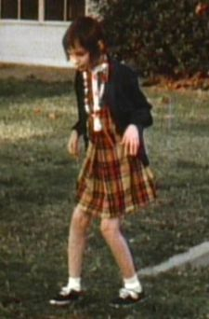
Research and socialisation
Taken into care
The first year: HOPE
plural and singular nouns,
positive and negative sentences
2/3-word sentences.

Slide 19
Fodor’s modularity and psycholinguistics
Alienated syntax from semantics
nonlinguistic factors play no role in language computation
Mentalese
Language of thought argument

Slide 20
ENCAPSULATION AND INACCESSIBILITY.
Informational encapsulation and limited central accessibility are two sides of the same coin. Both features pertain to the character of information flow across computational mechanisms, albeit in opposite directions. Encapsulation involves restriction on the flow of information into a mechanism, whereas inaccessibility involves restriction on the flow of information out of it.
A cognitive system is informationally encapsulated to the extent that in the course of processing a given set of inputs it cannot access information stored elsewhere; all it has to go on is the information contained in those inputs plus whatever information might be stored within the system itself.

Slide 21
MANDATORINESS, SPEED, AND SUPERFICIALITY.
The operation of a cognitive system is mandatory just in case it is automatic, that is, not under conscious control (cf. Bargh & Chartrand, 1999). This means that, like it or not, the system's operations are switched on by presentation of the relevant stimuli and those operations run to completion. For example, native speakers of English cannot hear the sounds of English being spoken as mere noise: if they hear those sounds at all, they hear them as English. Likewise, it's impossible to see a 3D array of objects in space as 2D patches of color, however hard one may try (despite claims to the contrary by painters and other visual artists influenced by Impressionism).

Slide 22
Different Theories - The modularity hypothesis of language
The Mind/Brain
{
Big Modularity
Language
General Cognition
}
Lexicon
‘irregulars’
Rule System
‘regulars’
Little Modularity
Notes:
“…. WS language is impressive for a retarded population, but it is by no means entirely intact. However, much debate has revolved around two questions: is WS language at least selectively spared relative to the rest of cognition [= Big Modularity], and does the pattern of linguistic strengths and weakness reflect theoretically interesting divisions within language [= Little Modularity]? -Zukowski 2001:5
“If language is an instinct, it should have an identifiable seat in the brain, and perhaps even a special set of genes that help wire it into place. Disrupt these genes or neurons, and language should suffer while the other parts of intelligence carry on; spare them in an otherwise damaged brain, and you should have a retarded individual with intact language, a linguistic idiot savant. If on the other hand, language is just the exercise of human smarts, we might expect that injuries and impairments would make people stupider across the board, including their language.” Pinker xxxx:45)

Slide 23
Different Theories – “Mentalese”
The medium of thought is an innate, behind-the-scenes language known as mentalese. (e.g., Fodor, 1975; Pinker, 1994)
"Mentalese" is supposed to be an inner language that contains all of the conceptual resources necessary for any of the propositions that humans can grasp, think or express--in short, the basis of thought and meaning.
Natural language would not in itself shape the human mind in any fundamental way, although the internal mentalese thoughts being represented by the natural language sentences would.

Slide 24
Fodor's Language of Thought (LOT) Hypothesis
Including five components:
(1) Representational Realism: Thinkers have explicit representational systems; to think a thought with a given content is to be appropriately related to a representation with the right meaning, e.g., to have the belief that capitalism breeds greed is to have a representational token with the content "capitalism breeds greed" in one's belief box.

Slide 25
Fodor's Language of Thought (LOT) Hypothesis
Including five components:
(2) Linguistic Thought: The (main) representational system that underlies human thought, and perhaps that underlies thought in other species too, is semantically and syntactically language-like, i.e., it is similar to spoken human languages. Specifically, this representational system consists of syntactic tokens that are capable of expressing propositional meanings in virtue of the semantic compositionalilty of the syntactic elements. E.g., there are mental words that express concepts (and the like) that can be formed into true or false mental sentences.

Slide 26
Fodor's Language of Thought (LOT) Hypothesis
Including five components:
(3) Distinctness: The language of thought is not identical to any spoken language.
(4) Nativism: There is a single genetically determined mental language possessed by humans, and perhaps (at least partially possessed) by all other thinking species.
(5) Semantic Completeness: This language is expressively semantically complete--any predicate that we are able to semantically comprehend is expressible in this language.

Slide 27
Jackendoff, R. (2002) Foundations of Language: Brain, Meaning, Grammar, Evolution
If UG is not learned, how does the child acquire it? The only alternative is through the structure of the brain, which is determined through a combination of genetic inheritance and the biological processes resulting from expression of the genes, the latter in turn determined by some combination of inherent structure and environmental input.

Slide 28
Jackendoff, R. (2002) Foundations of Language: Brain, Meaning, Grammar, Evolution
Generative grammar was mistaken to assume
the syntactic component is the sole course of combinatoriality, and everything else is "interpretive.“
The proper approach is a parallel architecture, in which phonology, syntax, and semantics are autonomous generative systems, linked by interface components.
The parallel architecture leads to an integration within linguistics, and to a far better integration with the rest of cognitive neuroscience

Slide 29
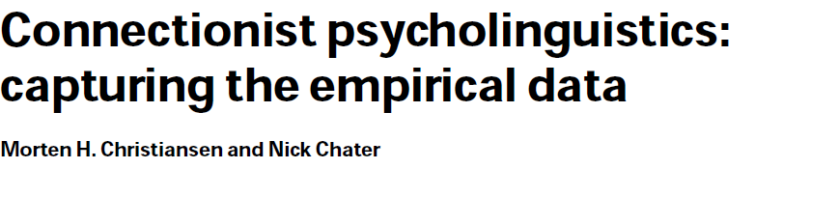
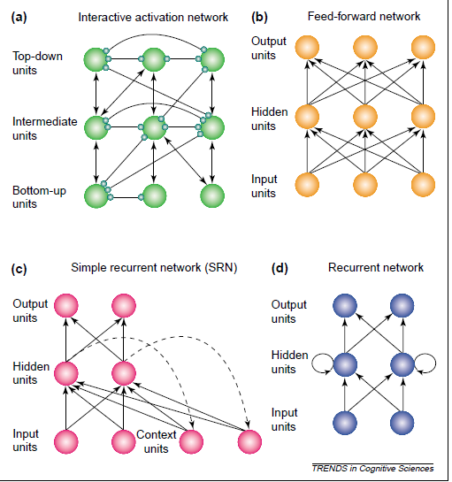


Slide 30
To be continued

